Slide 1
Robotics Assignment
ARI2202
Nathan Bonavia Zammit, Benjamin Joseph Spiteri, Roman Országh

Slide 2
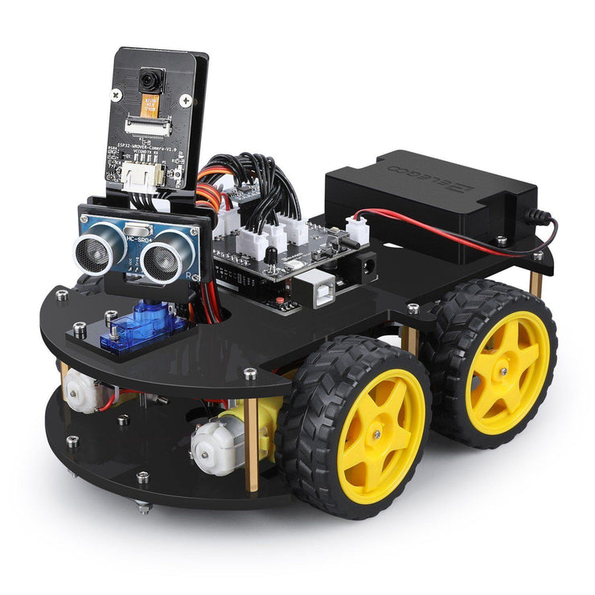
What was the task at hand?
Elegoo Smart Robot Car kit
Multiple different modules
Line-Tracking Module
Ultra sonic sensor module
GY-521 module (Gyroscope)
Obstacle Course

Slide 3

Starting Position
Rotation until Line Detection
PID used for rotation of 90 degrees
Allows for correct alignment

Slide 4
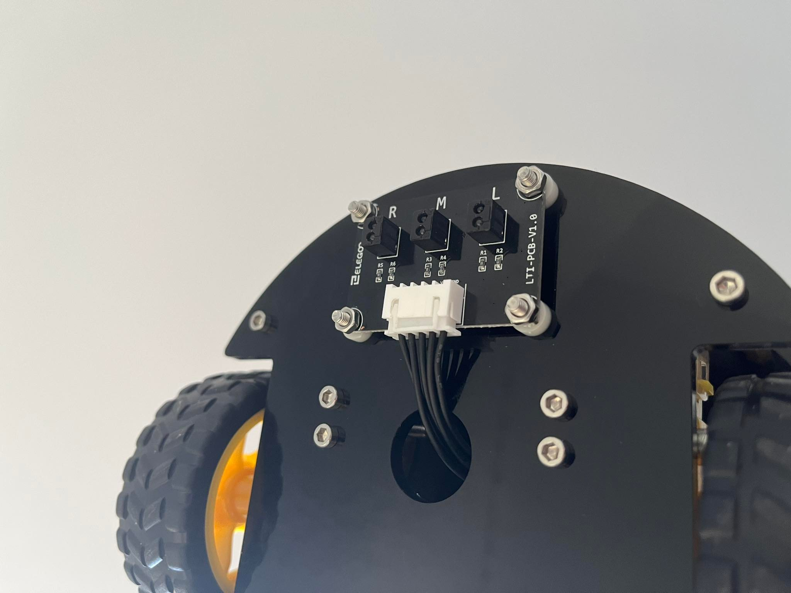
Line Counting
‘X’ number of lines were used
Line-tracking module was used to count them
The use of LED lights
Threshold issues and how they were catered for

Slide 5
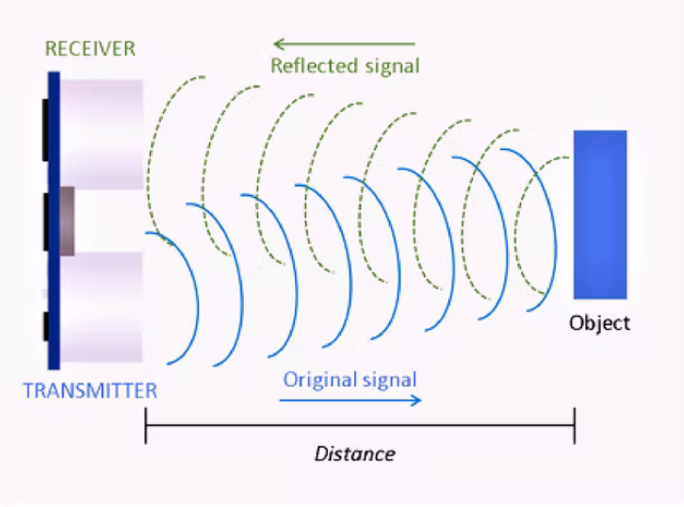
Object Avoidance
Ultrasonic Sensor Module was used
Servo motor was used for multiple angles
Was used to avoid any collisions
Narrow Field of view came into play

Slide 6
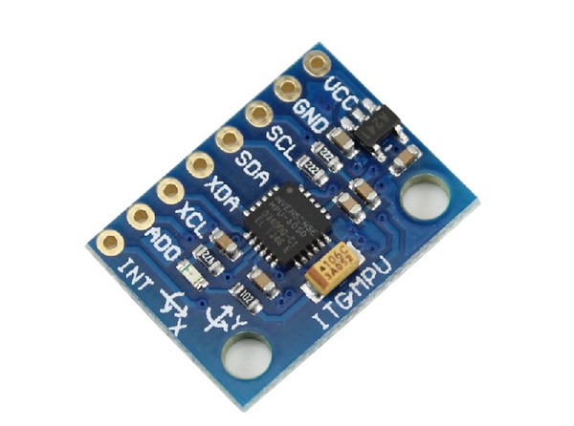
PID
Proportional Integral Derivative
What was the expected outcome
Delay Issues

Slide 7
Thank you for listening
Any Questions?

